Slide 1
What is ChatGPT?
Discover an AI Chat Model, to automatically create text within a Chat interface.

Slide 2
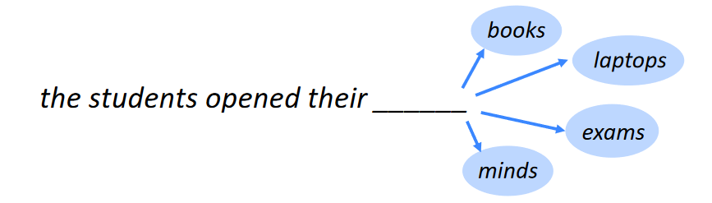
What would be the next word in this sentence?
Source

Slide 3
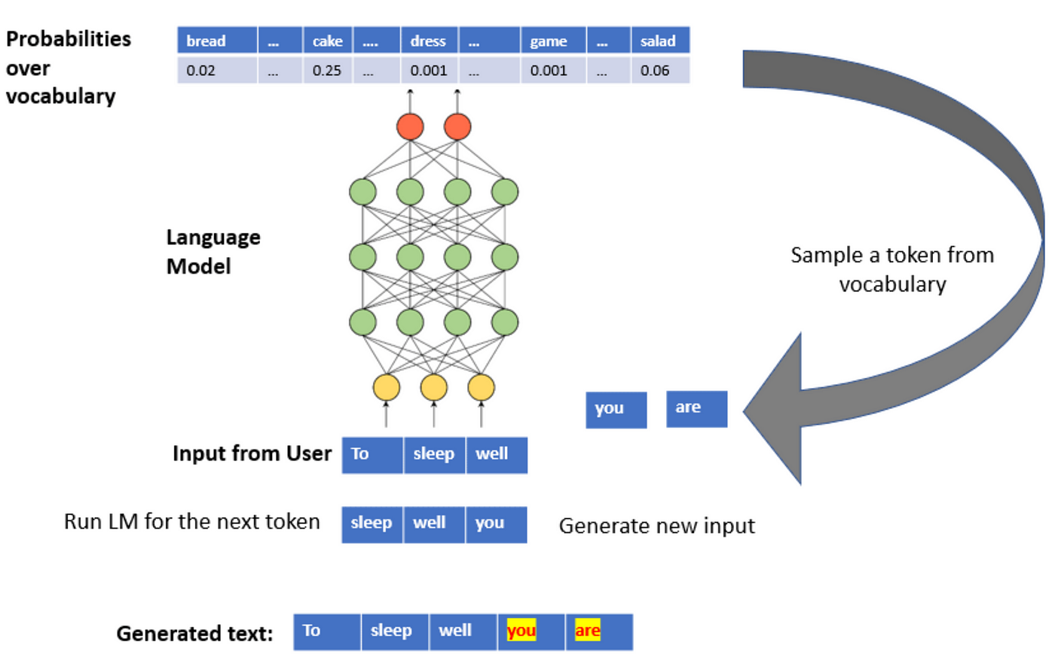
Predicting The Next Word (token)
A large language model is selecting the next most probable word, given a known vocabulary.
Source

Slide 4
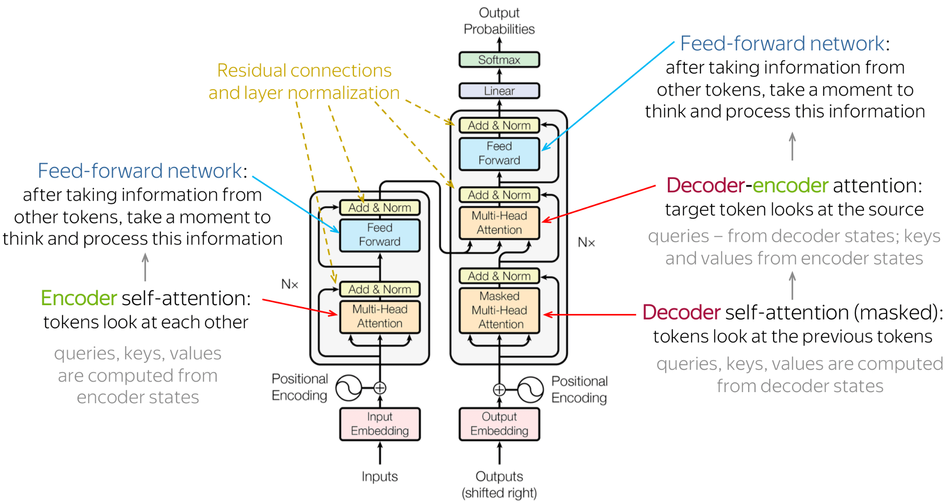
Transformer Models
Source

Slide 5
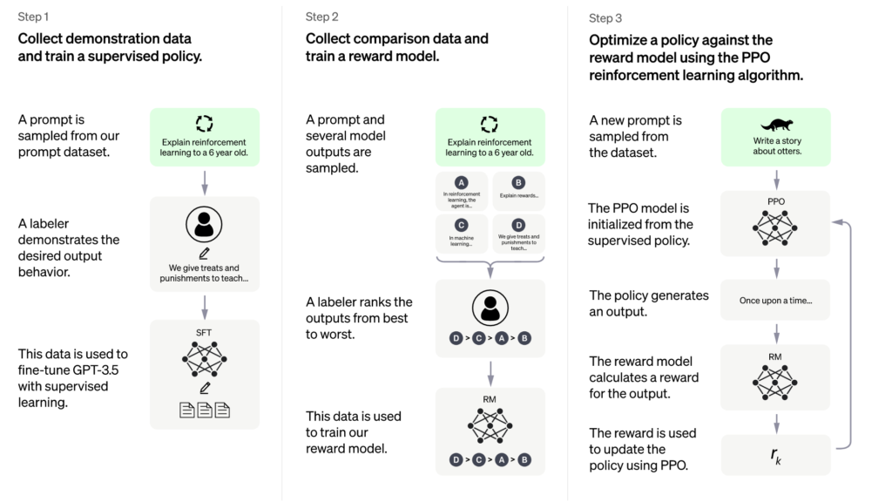
Training ChatGPT
Source

Slide 6
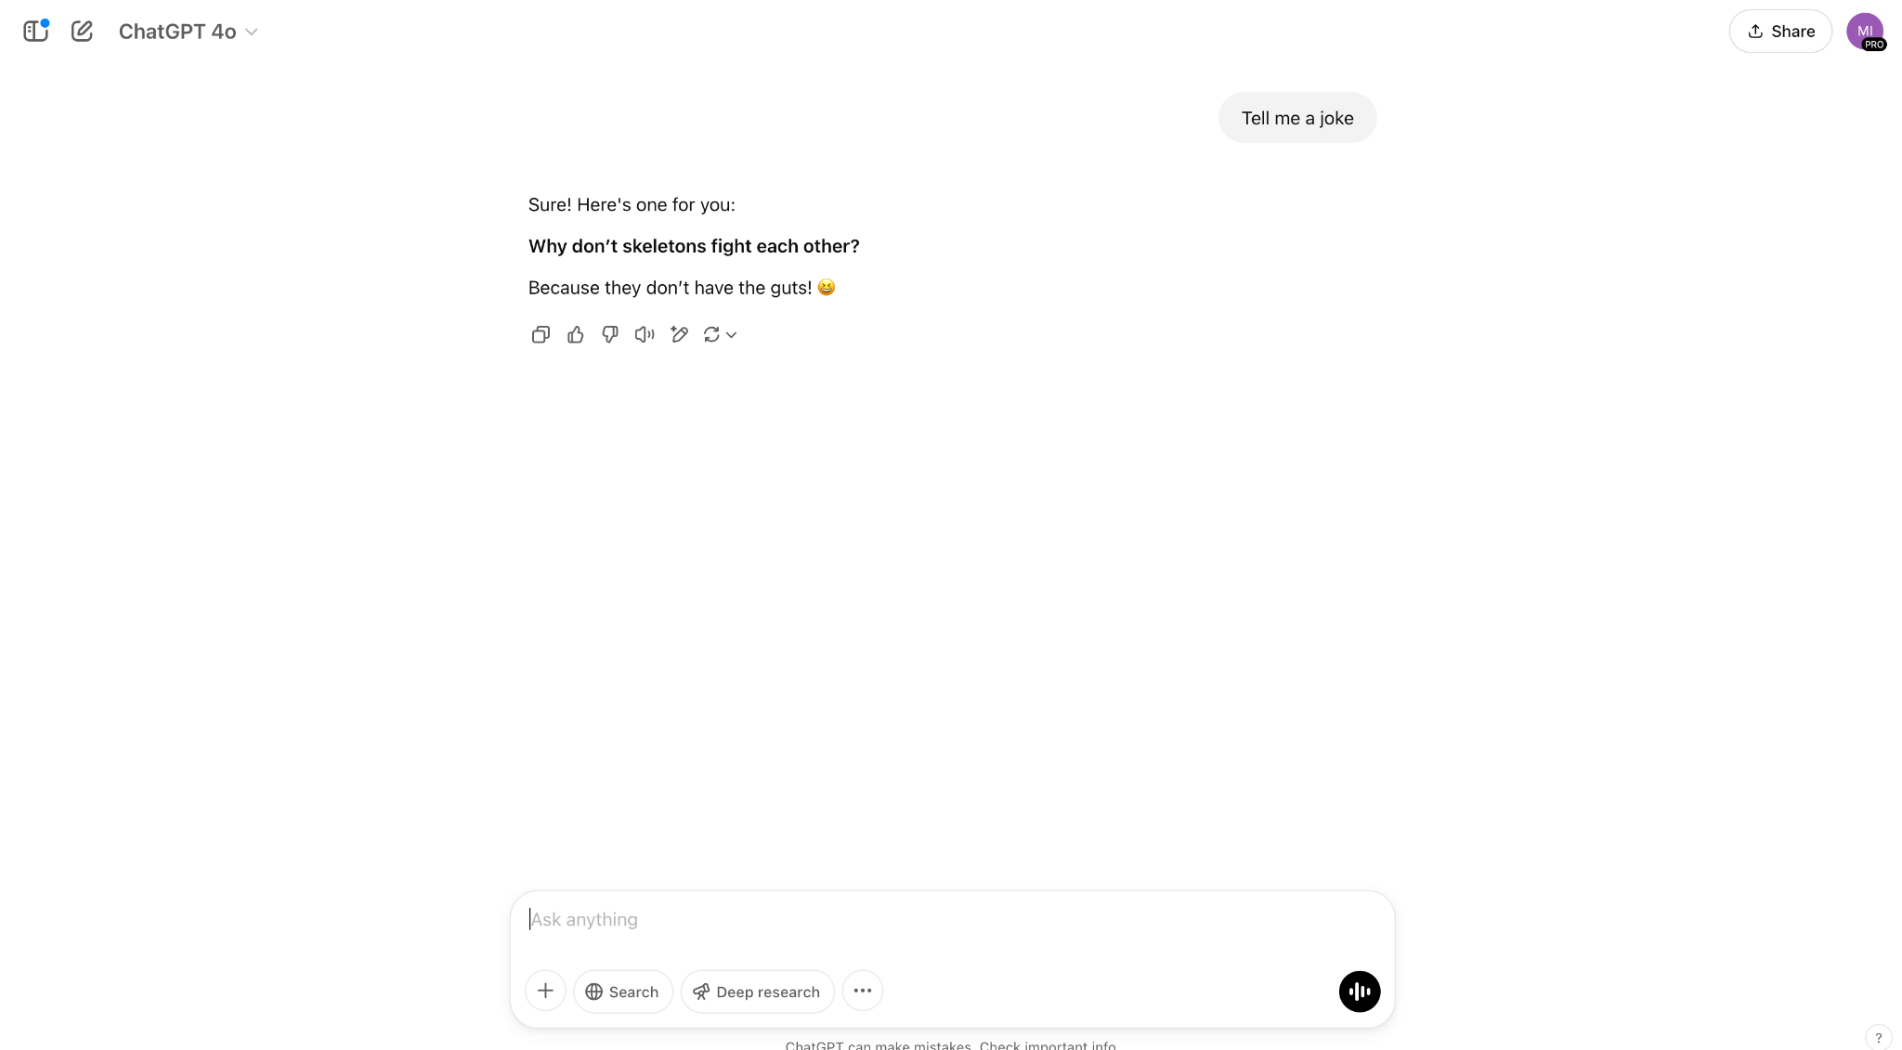
ChatGPT
Created by OpenAI
Accessed at chat.openai.com
Free or a ChatGPT plus or pro version (which comes with higher up-time and more features).

Slide 7
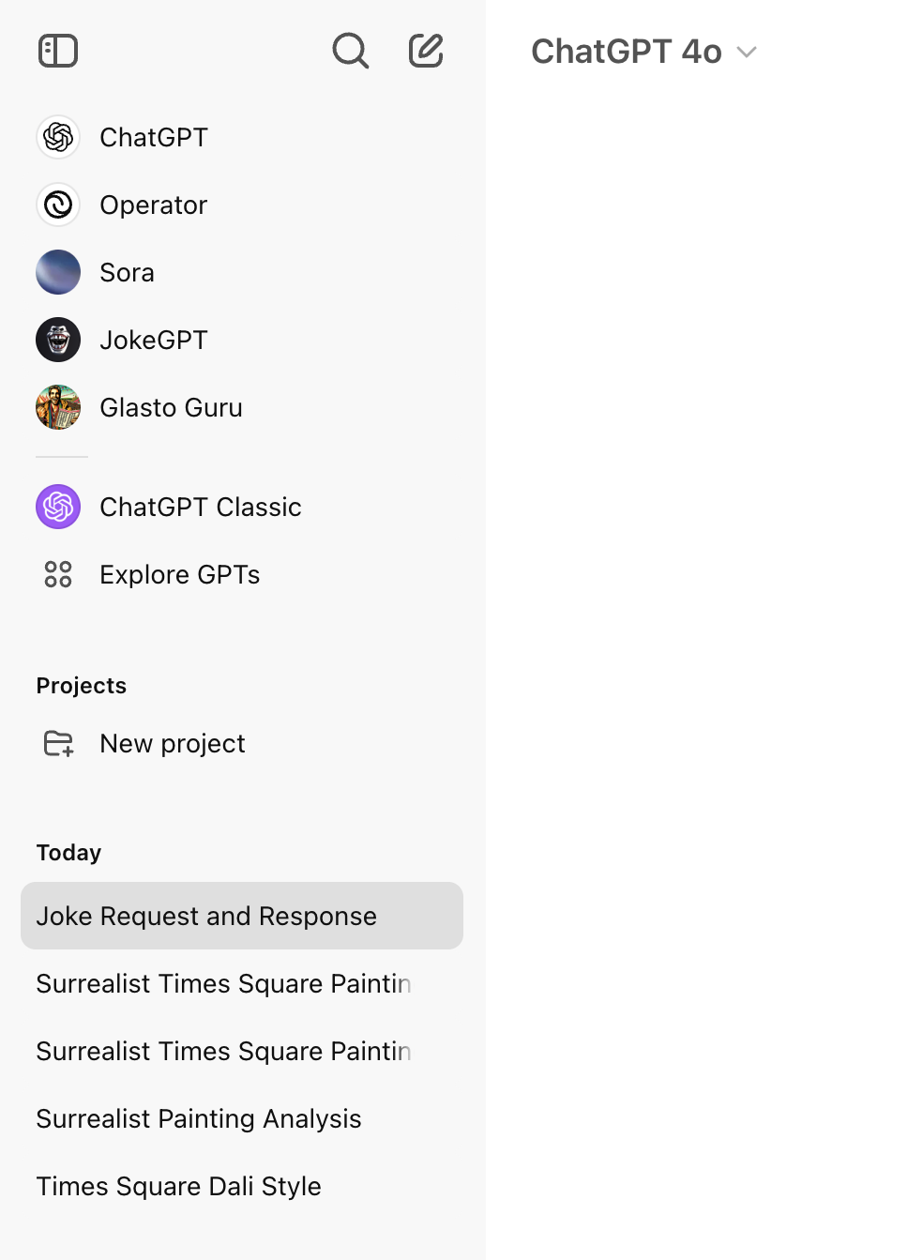
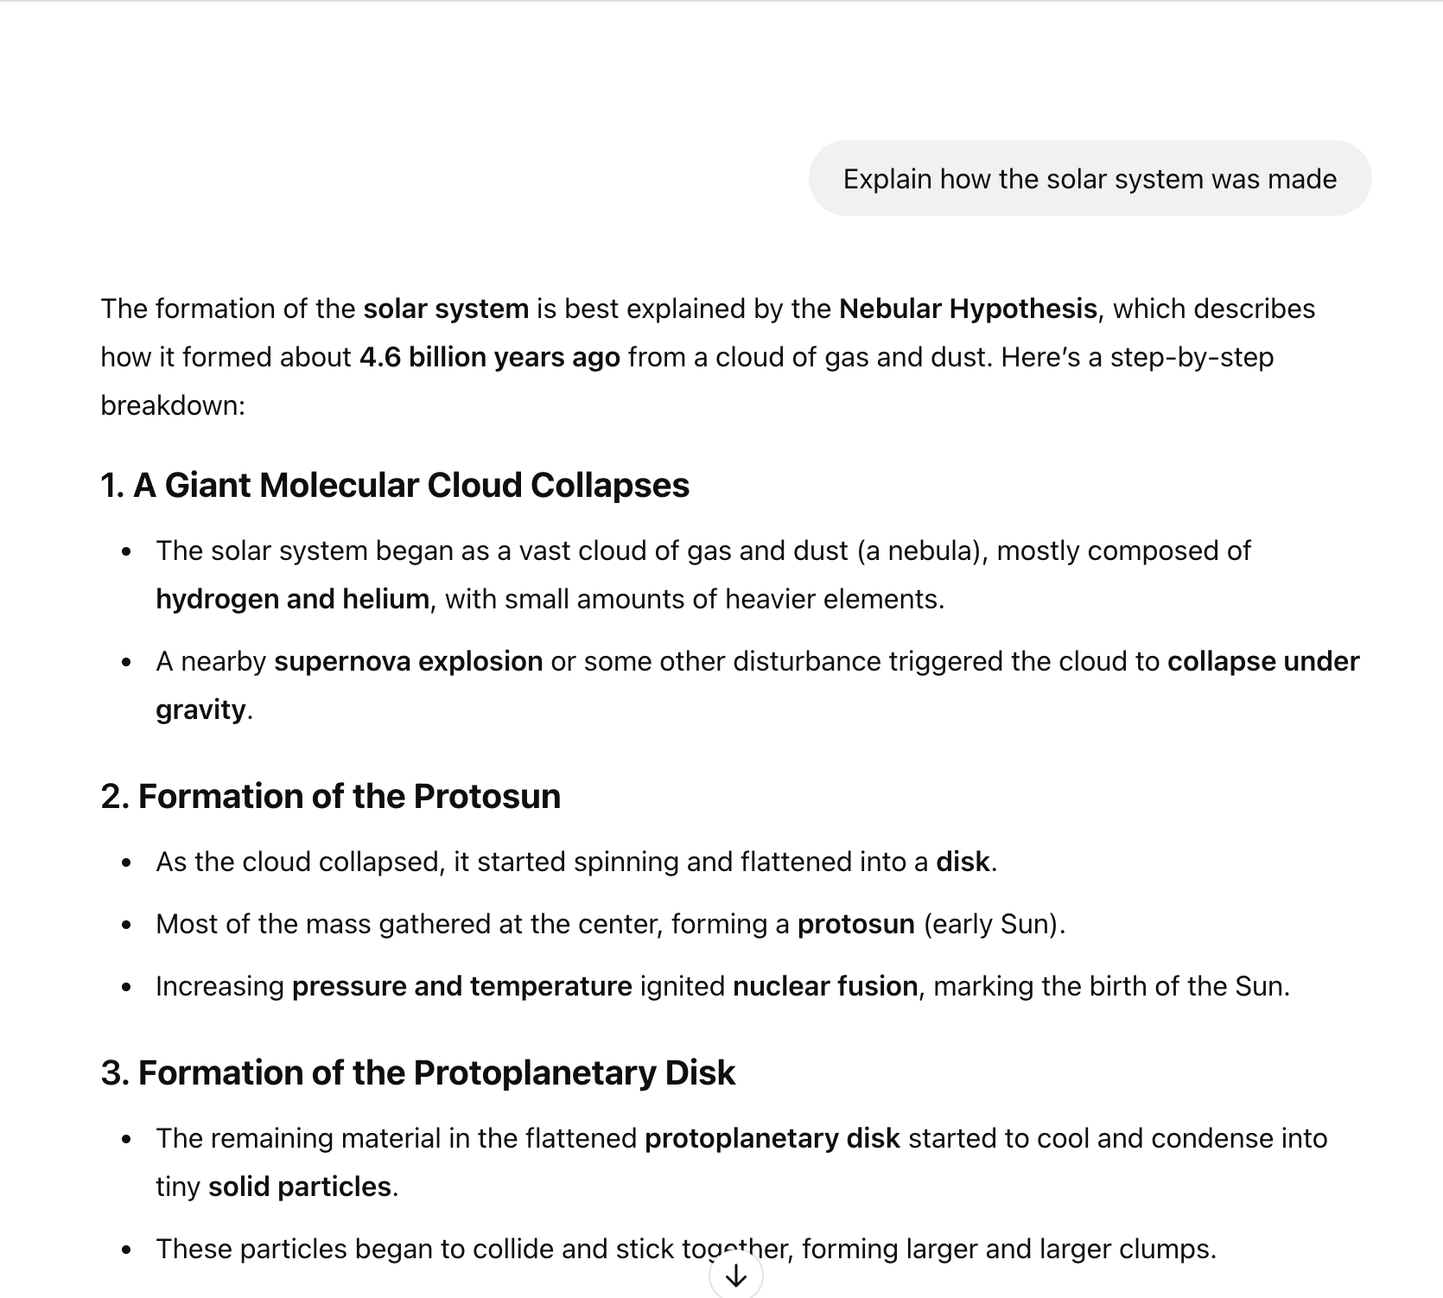
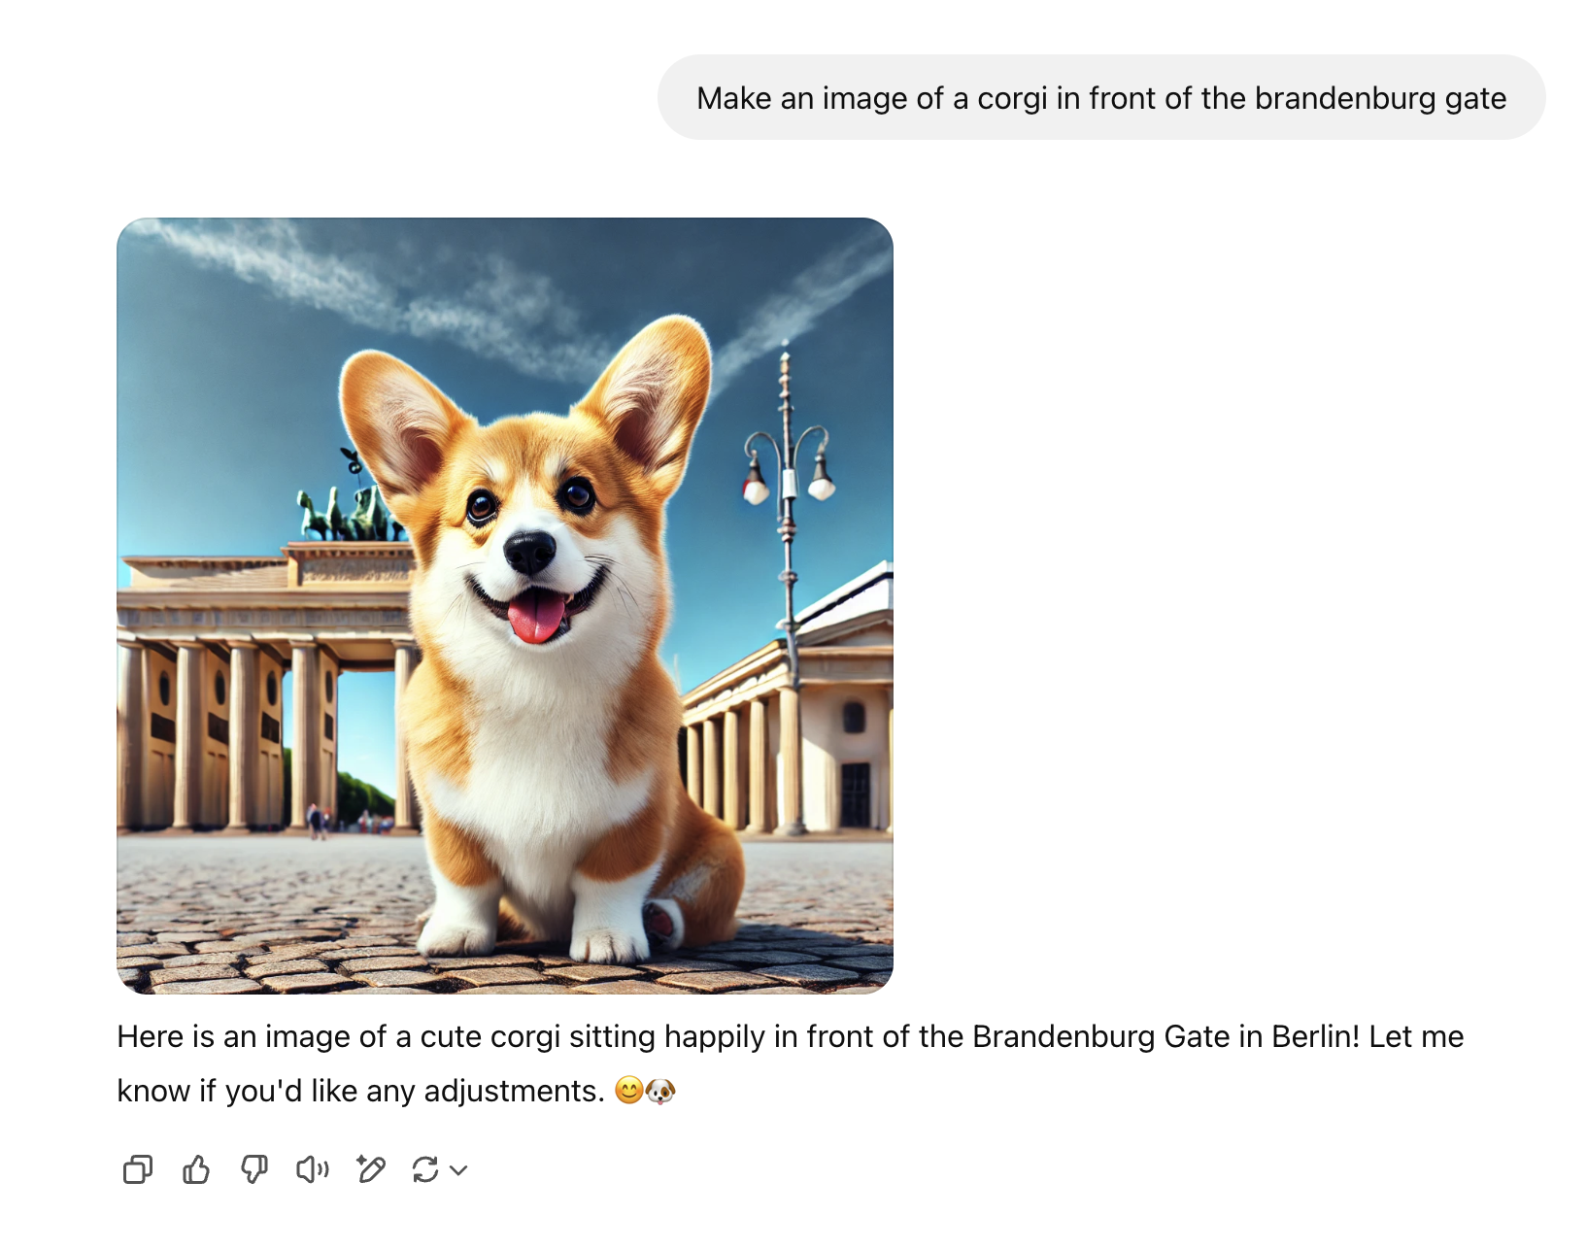
ChatGPT Features
Chat History
Text Generation
Image Generation

Slide 8
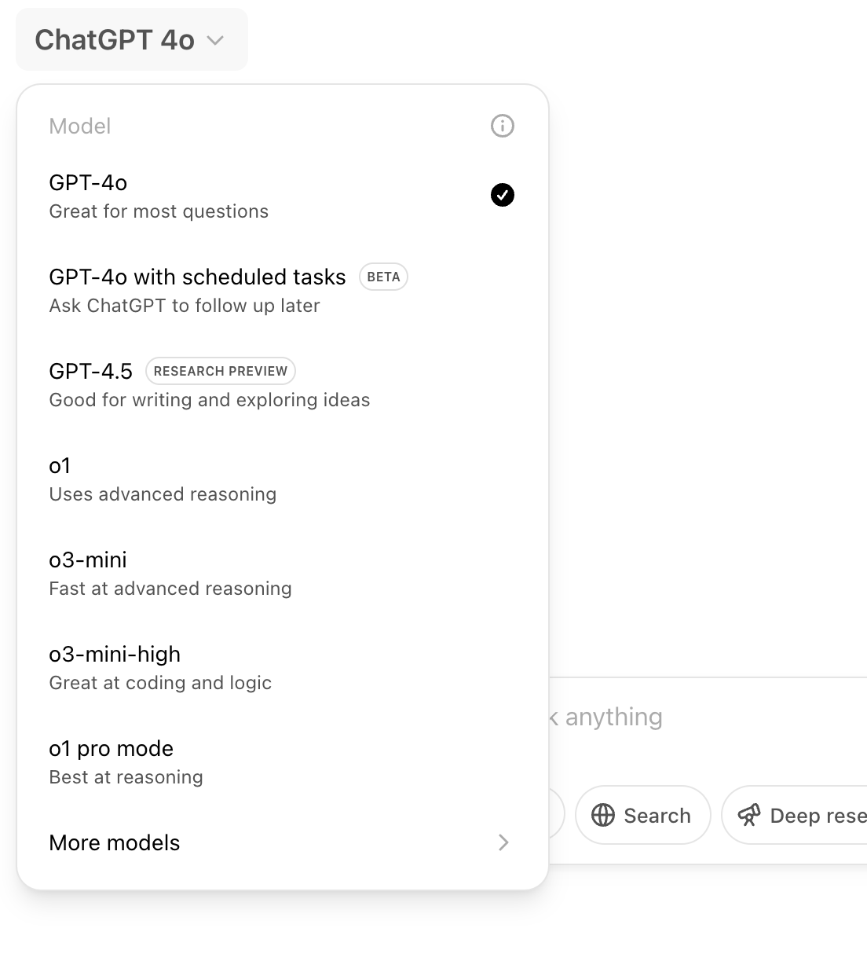
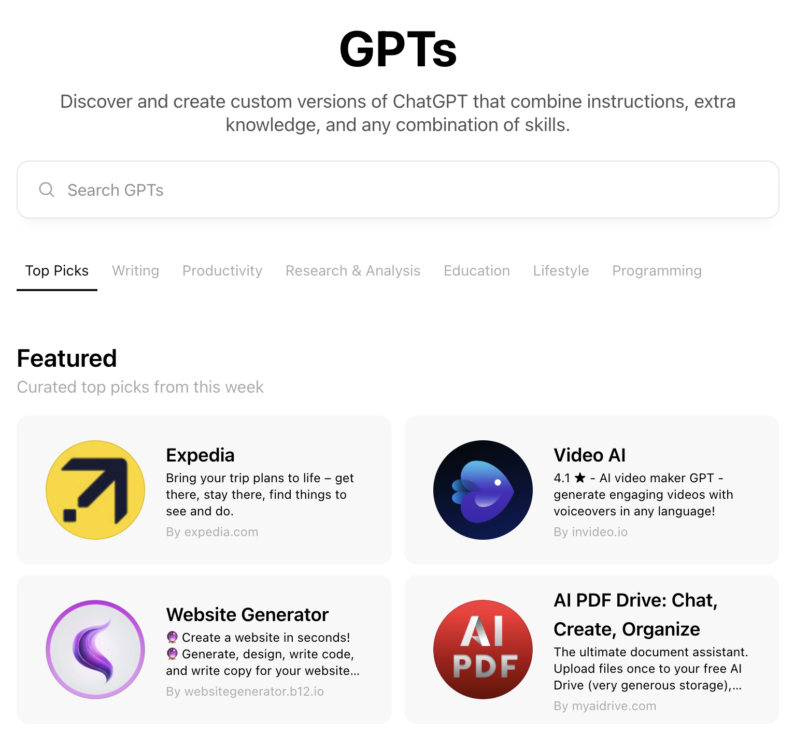
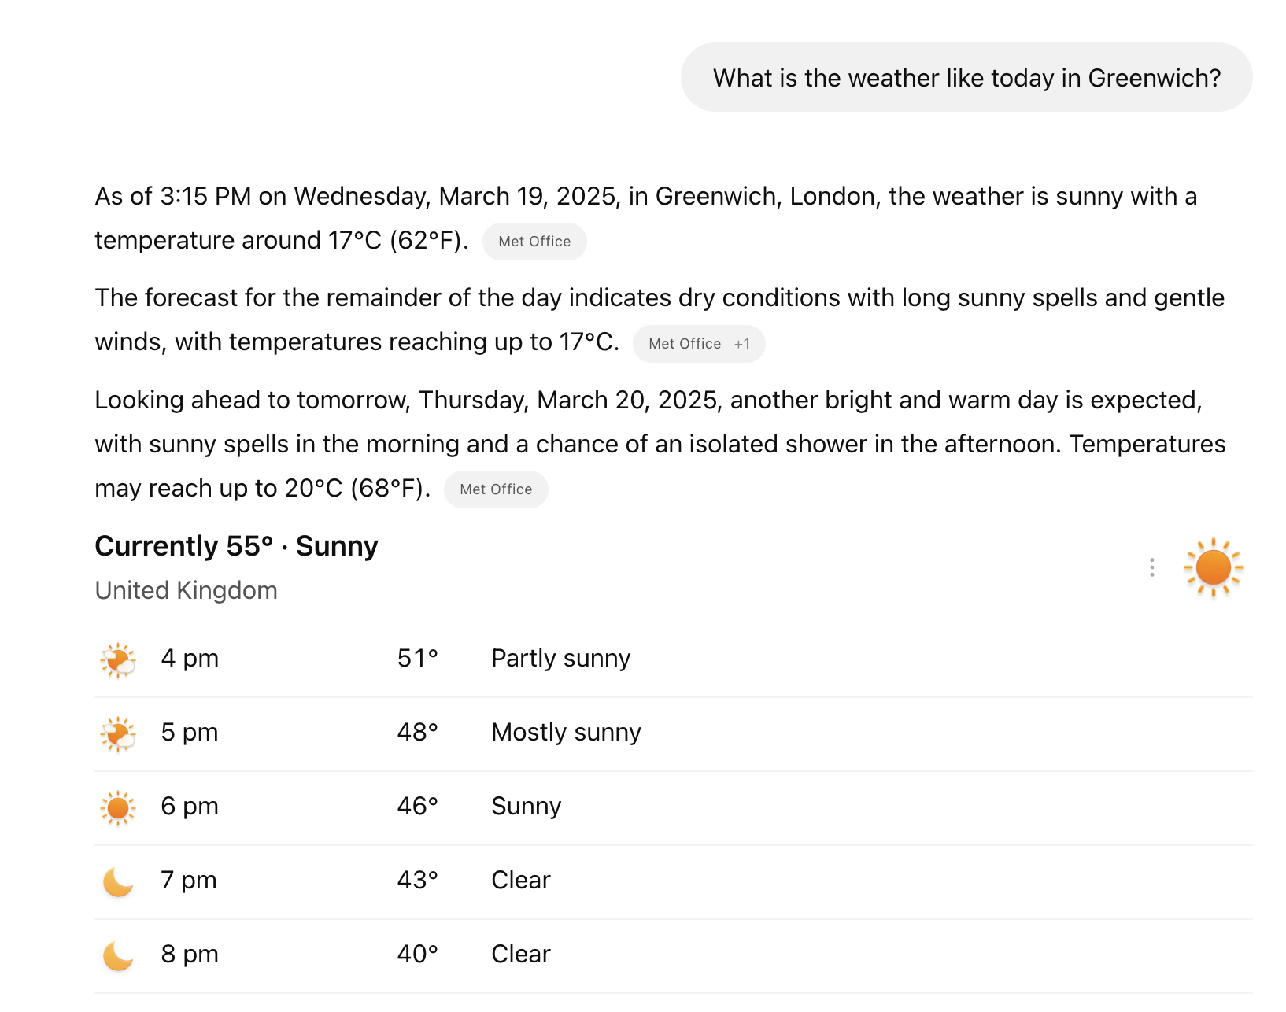
ChatGPT Features
Web Browsing
Powerful Models
Custom GPTs

Slide 9
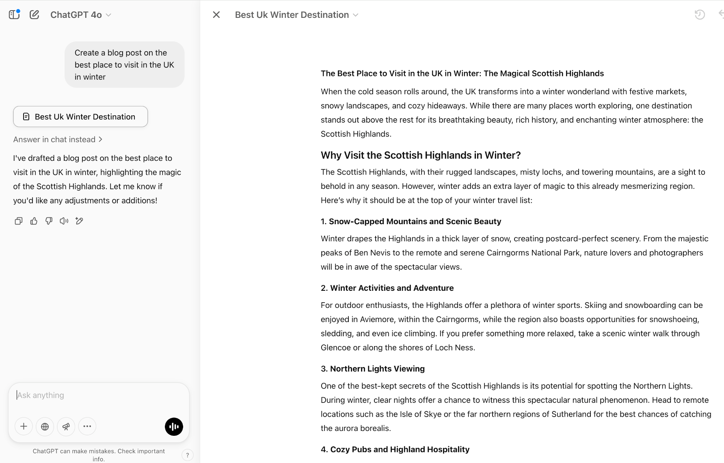
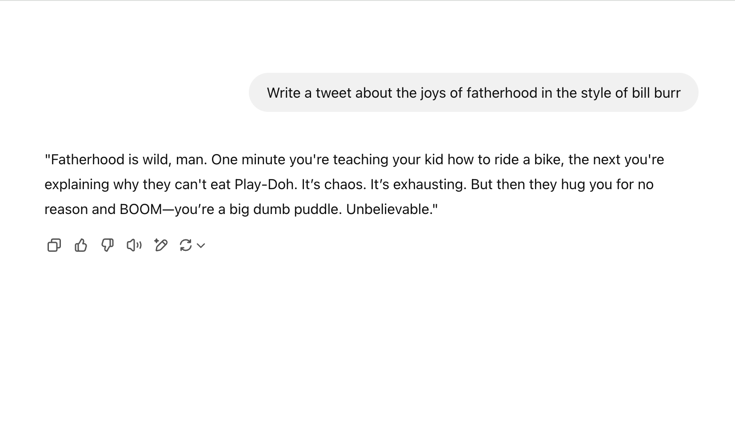
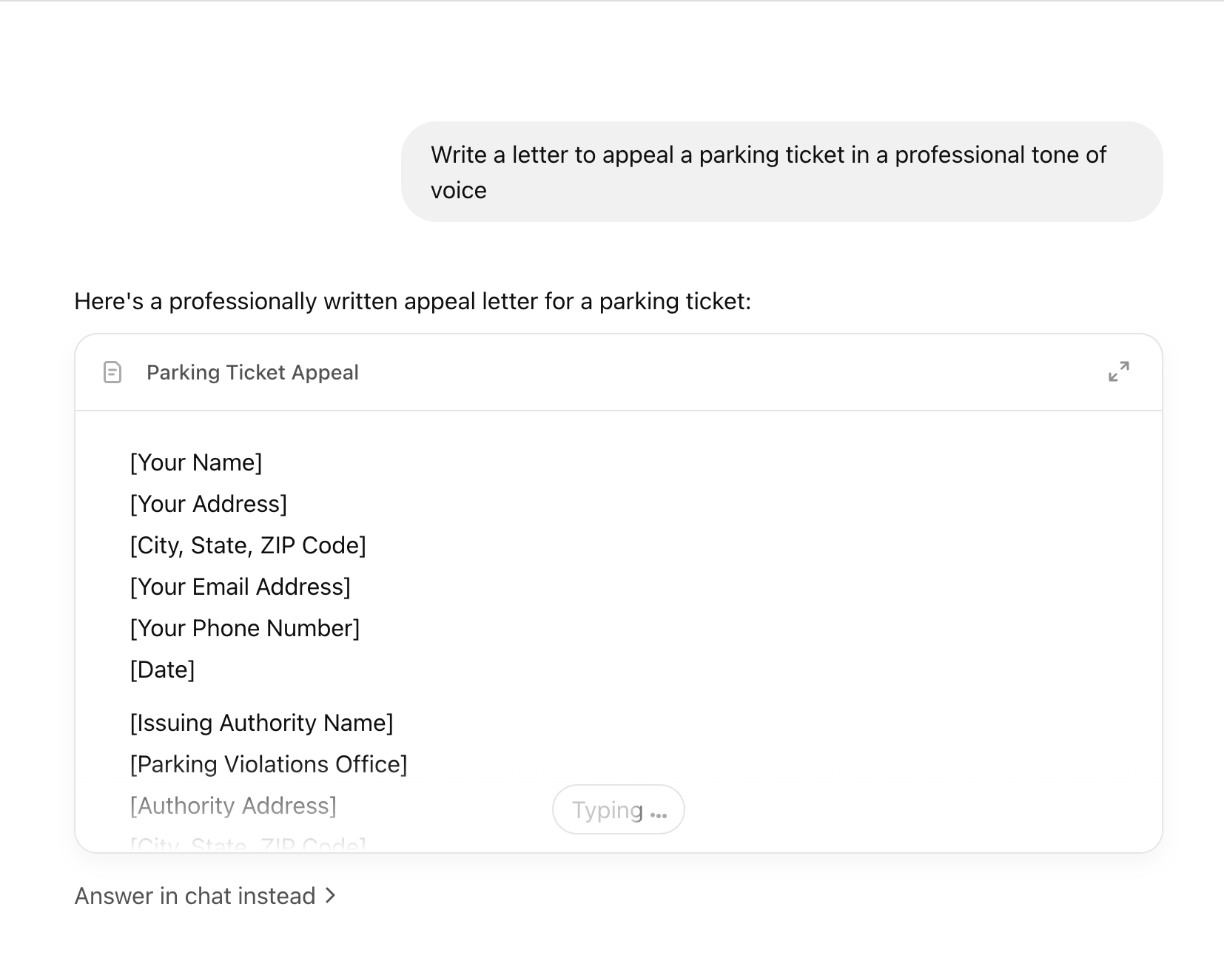
ChatGPT Use Cases
Blog Posts
Social Media
Automating Tasks

